Slide 1

VOTE NET
We Power Democracy

Slide 2

Problems
Remote Voting not allowed for Travelling class.
Transparency
Data Security in current system.

Slide 3
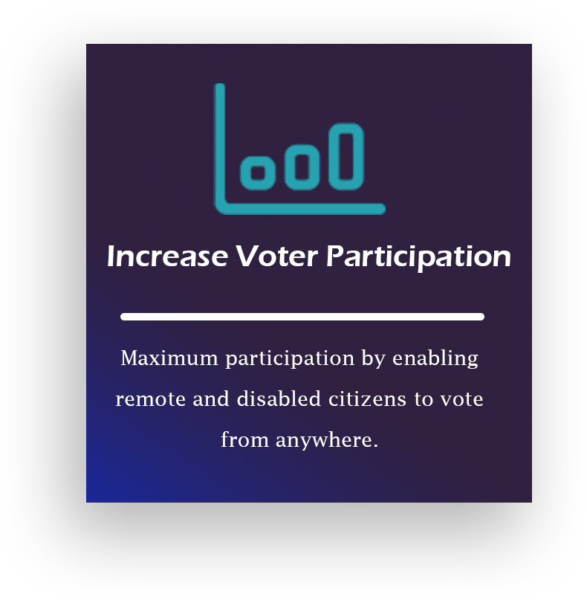
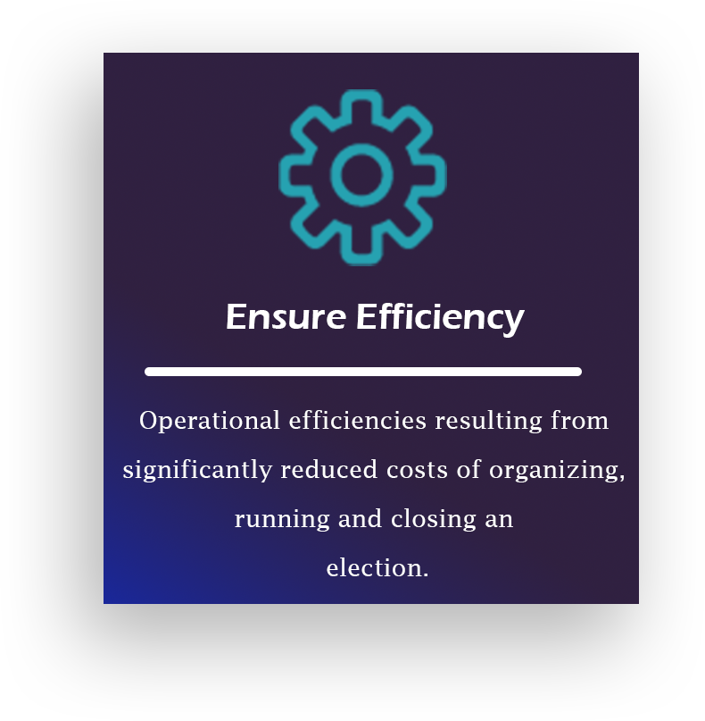
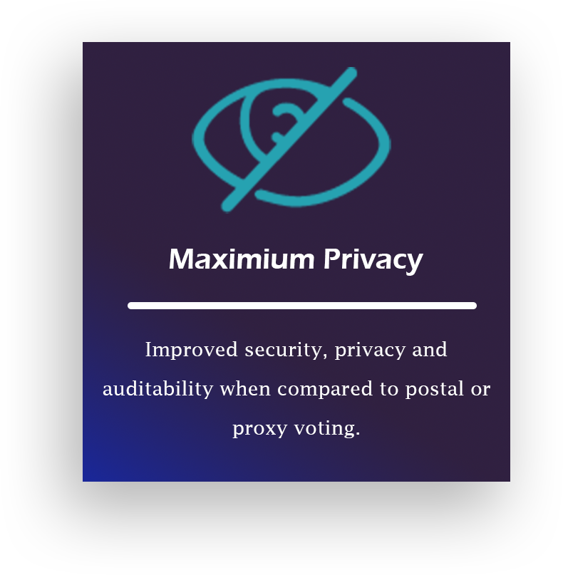
Solution
We propose a system that allow voters to vote remotely by visiting a VoteNet booth nearest to them.

Slide 4
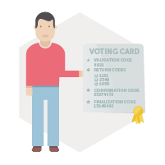
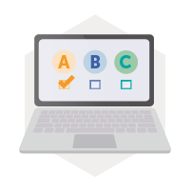

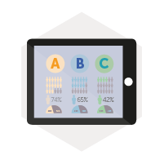
USE ??
1
2
3
4
Voter Authentication & Credentials
Remote Voting
Ballot Box Recording & Verification
Blockchain to keep data secure & transparent

